Slide 1
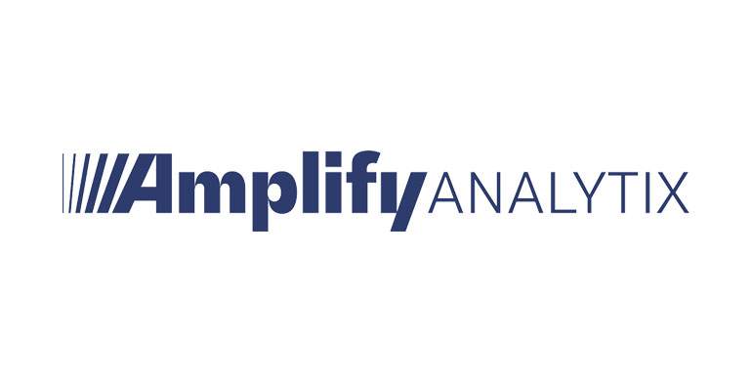
Business Case Study: Chicago Air 1
Assignment prepared by: Harsh Vardhan

Slide 2
Introduction
Objectives of the study
Data description
Inferences derived
Conclusion
Contents

Slide 3

Introduction
This activity is has been carried out as a part of an assignment for Amplify Analytix, which deals with exploratory data analysis and providing insights for its client.
An airline, operating out of the Chicago, Illinois area in the United States called Chicago Air 1 has a strong airline operations background, but don’t have much financial or data analytics experience. Many of their systems are disparate and not connected. You were shocked to find out that until just recently, the airline could not pull specific aircraft details, such as route and seating capacity, from a single report, but rather needed to open two or more files and compare the information. The airline has recently been able to connect their data sources and have put together charts and graphs using the data. The company needs your help interpreting the data to drive their strategic decisions to grow and position themselves in the market.

Slide 4

Objectives of the Study
Exploratory analysis done over the data including cleaning, munging, combining, reshaping, slicing, dicing, and transforming data for analysis purpose.
What is the as-is state? Where does the airline make the most profit and where does it suffer (think routes, airports, airplanes, any combination you think is important)?
Identify quick wins – are there any immediate improvements that the airline can implement to reach higher profitability?
Where should they focus in the long-term? What is the most impactful strategy and why?
Provide graphs that tell a story about the data.

Slide 5

Data Description or spread of data
Most popular routes/ months of operation
Share of flights by Aircraft type
(Profitability/Cost) ratio for
Distribution of cost incurred {Total Cost = List Price + (Fuel Cost per SeatMile * Seat Capacity * Distance)}
Profitability by Aircraft type/ routes {Profitability = Total Fare + Total Cost}

Slide 6

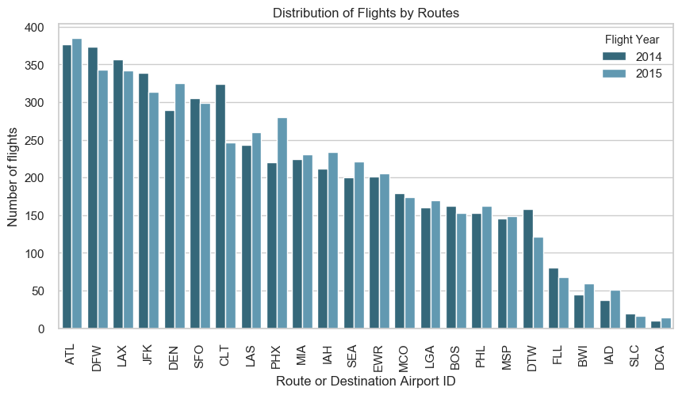
Most Popular Routes
ALT, DFW and LAX are the 3 most common routes for Chicago Air-1 with over 700 flights each flying to these 3 destinations over the 2 years.
DCA, SLC and IAD are the 3 least popular routes with less than 100 flights flying to each of these destinations.

Slide 7
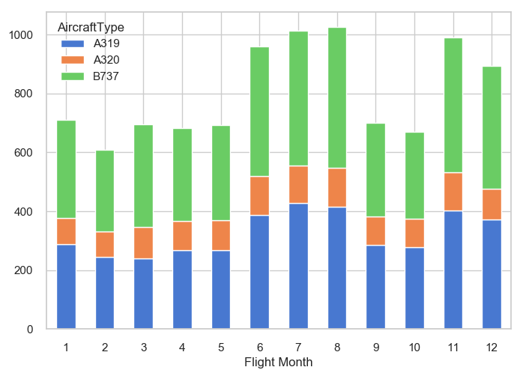
There seems to be 2 seasons in which travel picks up for the airlines: Jun-Aug and Nov-Dec where number of flights close in to 1000 a month.
Share of Aircrafts is mostly uniform across the year.
In the peak seasons, there could be a case of flying B737 fleets more frequently as they can accommodate more passengers, which may in turn reduce operational costs.
The trend is similar for both the years, and no major shift can be observed.
Flights distributed by Months

Slide 8
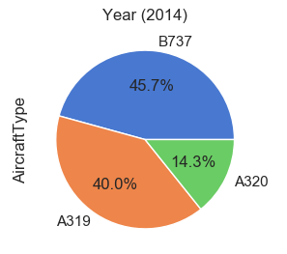
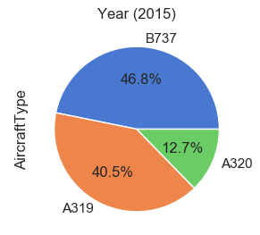
Share of Flights by Aircraft Type
Percentage of total flights by Aircraft Type category.
B737 is the most common aircraft type which had more than 46% (close to 4500 among a total of 9636 flights) of the total flights.
A320 flights comprise of only 13.5% overall.
There has been a slight increase in the number of flights flown by B737 aircraft at the expense of A320 aircraft.

Slide 9
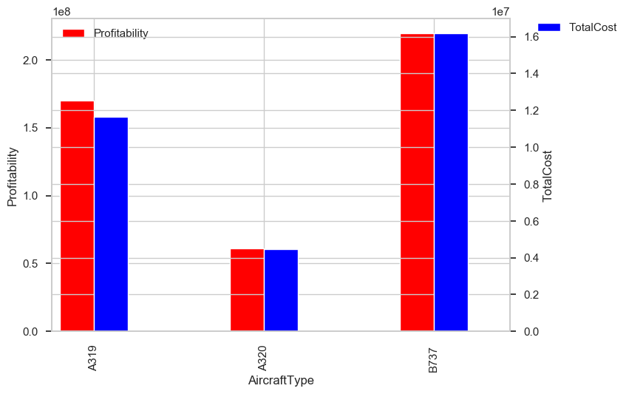
Profitability with costs by Aircraft Type
Profitability/Costs ratio is greater than 14:1 for all aircraft type.
There is no significant difference in the ratio for the 3 flights, with A319 being the most profitable aircraft per UD$ of cost incurred.
The trend is similar for both the years, and no major shift can be observed.

Slide 10
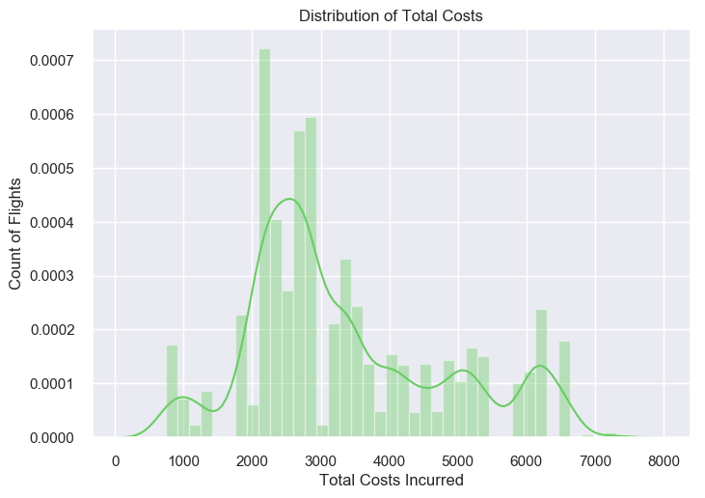
There are many peaks across the width of histogram, which may be due to the varying costs on different routes. Therefore, costs may be interrogated separately for separate routes.
Also, we may apply a cut-off for costs above the mean/ median of the spread of total costs, if the profits are not sufficient there.
Spread of Total Costs incurred
Central Tendencies | Value (USD)
Mean | 3354
Median | 2893
Mode | 2162

Slide 11
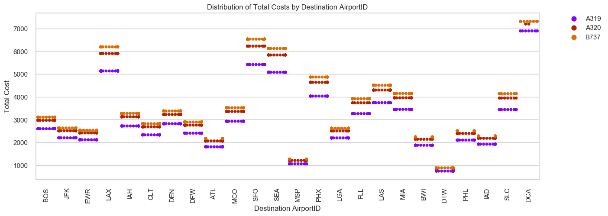
Distribution of Costs incurred by Airport ID This graph helps us explaining the various peaks in the graph for distribution of Total Cost (maximum observations at Cost = $2000- $3000). Cost for each flight for a destination has only 3 possible outcomes, distinguished by the Aircraft type. Cost for a B737 is always the maximum and that for A319 is the minimum. Expenses for Chicago Air 1 are maximum if flying to DCA (~$7000), followed by SFO, LAX and SEA. DTW and MSP on the other hand cost the lowest for the airlines.

Slide 12
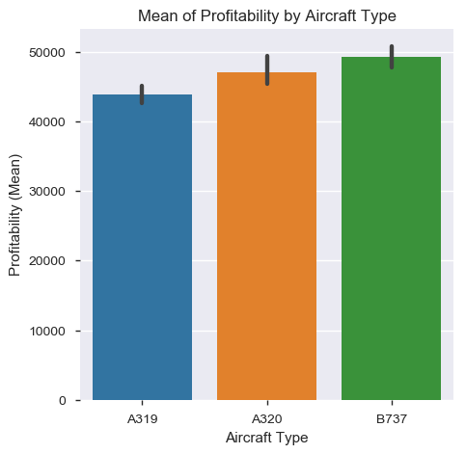
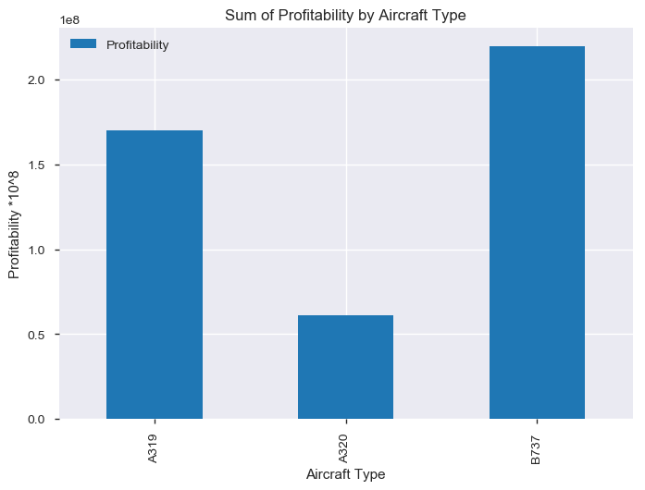
Profitability by Aircraft Type Maximum amount of profitability is generated by flights belonging to B737 (~USD 2.2 billions). Also, this Aircraft type has the highest mean profitability (~USD 50,000 per flight), which makes it the most profitable type for Chicago Air-1. The number of flights flown by A320 can also be increased as its mean profitability is higher than A319.

Slide 13


Inferences Derived
Relationship between Profitability and Costs by Aircraft type
Profitability and Costs by Routes
Profitability across months by Aircraft Type and routes
Profitability by Routes
Conclusions

Slide 14
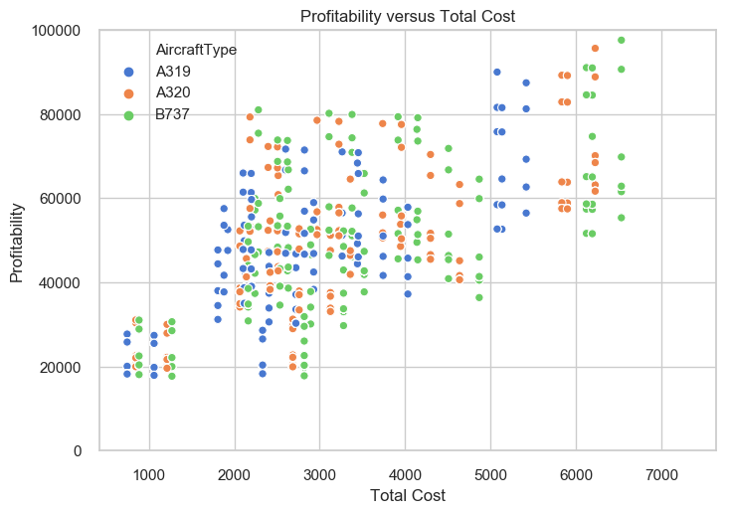
Profitability v/s Cost by Aircraft Type
There seems to be clear segmentation of groups and mostly airlines follow linear relationship between cost and profit.
It might actually be a good idea to invest more in A319 aircrafts, as the profitability spread is similar compared to other aircrafts at a lesser competitive price.
For routes costing more than $5,000, there is huge difference between costs incurred by A319 and others. The airlines should plan on flying more A319 here.

Slide 15
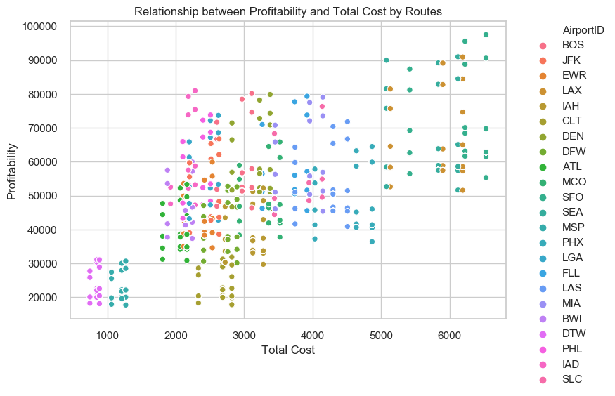
Profitability v/s Cost by Flight Routes
Airlines might want to investigate the routes which fall below the linear relationship line.
Mid-range routes (costs $2000-3000): CLT is one of the least profitable routes, along with DFW which yields lower profits than other in this segment. IAD, PHL are profitable routes in this segment.
Higher costs ($6000+): Profit amounts SFO and SEA routes are grouped in 2 parts. Airlines should surely look into the group yielding low profits (slide 18).

Slide 16
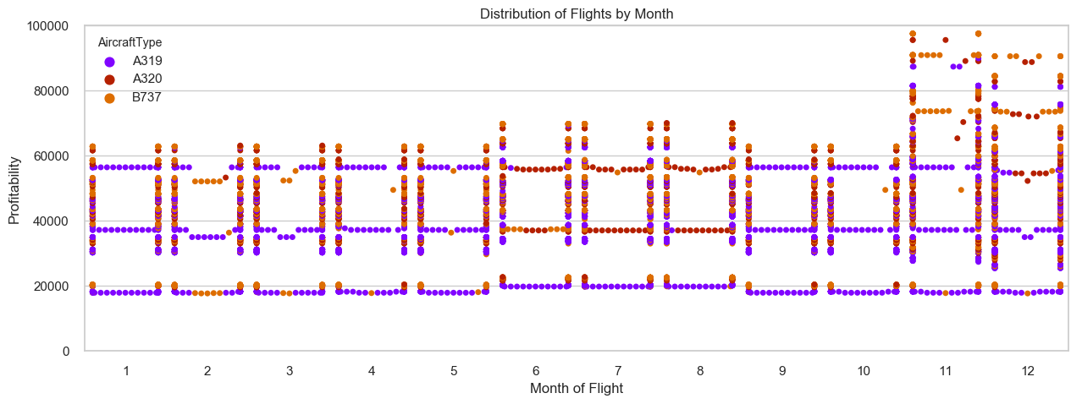
Profitability by Months As explained in the previous slide, Profitability is despairingly high compared to other months.
Although, the number of flights in operation are highest for Jun-Aug, the profitability appears to be on the lower side. Thus the airlines might want to investigate into the operation costs of these flights.
Compare costs and profitability of A319, as the distribution of profits are sparse for this aircraft.

Slide 17
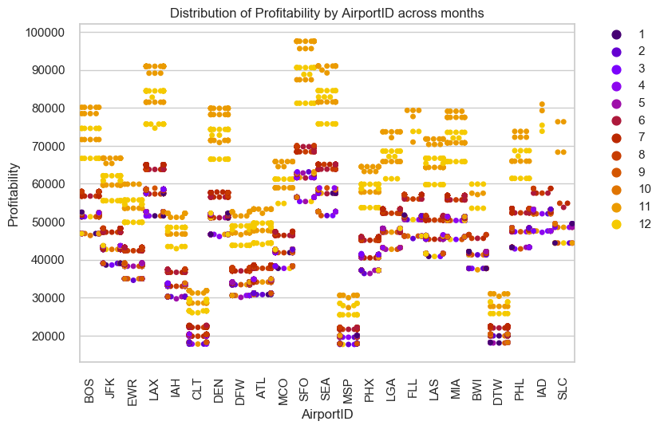
Profitability by months
Highest profitability is observed in the months of Oct-Dec for mostly all destinations. This coincides with the second peak season.
Profitability is on the lower side for the months of Feb-Apr, which may be an off-season with flights not flying to full capacity.
Profitability for months with maximum flights (Jun-Aug) is in the lower range, which is a reason for concern, particularly for routes with profitability less than $4000.

Slide 18
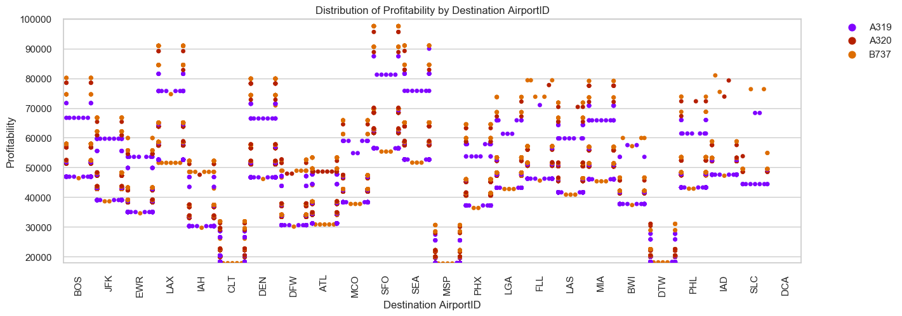
Profitability by routes and aircraft type The profitability axis has been capped at US$100,000 so as to observe the maximum variation. Profitability is maximum for DCA route (more than 8 times than the maximum among the other routes), but it can be considered as an outlier (one-off special route) (0.25% of the flights). SFO, SEA and LAX are among the next best route for Chicago Air 1 with mean profitability more than US$ 80,000 per flight. CLT, MSP and DTW are the routes which make least profit and have similar trend for profitability. No route make losses.

Slide 19
As-is state:
ALT, DFW and LAX are most common routes over 2014-15, while DCA, SLC and IAD are the least common.
Jun-Aug and Nov-Dec are busiest month for the airlines, although Jun-Aug is not as profitable.
B737 is the most commonly flown aircraft used, while A319 is the least flown.
DCA is the most profitable route (more than 8 times profitable than the next highest). SFO, SEA and LAX are the next most profitable routes in terms of the mean profits.
B737 aircraft generates the highest profit for a single trip for any given route and it is advisable to increase its frequency during peak season.
Cost incurred for flight to DCA is highest, pertaining to the high List Price. Though this cost is justified by the high profitability margins for the route.
Quick Wins:
For the months of Feb and March, some B737 aircrafts have made significantly lower profits than their counterparts. If this seems to be a trend for other years as well, you might want to reduce the operations during these months, or rather employ A319 for the purpose.
The profitability in the months of Jun-Aug (which happen to be the months when maximum number of flights operate) is not in the higher range. You may want to fly flights at maximum occupancy possible to optimize revenues. Also, could be a case of flying more B737 aircrafts during these months (as they amount for maximum profitability) and reduce the overall flights operational.
Conclusions from data

Slide 20
Quick Wins(cont…):
Flights to CLT, MSP and DTW can be reduced as they account for lowest profitability. You might want to fly to these locations only in the peak season (Oct-Dec) which have high profit margins.
It might actually be a good idea to invest more in A319 aircrafts for routes costing more than US$5000, as the profitability spread is similar compared to other expensive aircrafts at a lesser competitive price.
The profitability in the months of Jun-Aug (which happen to be the months when maximum number of flights operate) is not in the higher range. You may want to fly flights at maximum occupancy possible to optimize revenues. Also, could be a case of flying more B737 aircrafts during these months (as they amount for maximum profitability) and reduce the overall flights operational.
Flights to CLT, MSP and DTW can be reduced as they account for lowest profitability. You might want to fly to these locations in peak season (Oct-Dec) which have high profit margins.
Long-term focus:
Optimize flight schedule for the off-season period of Feb-Apr, which yields very low profitability.
Increase the fleet size of B737 at the expense of A320 as the average profit yielded by B737 is much higher.
IAD, PHL are highly profitable routes in low-price segment. You might want to investigate any scope to capture more market for this route, if there is any demand.
SFO, SEA and LAX are among the high profit yielding routes for Chicago Air 1. If there is a genuine increase in demand you might want to increase your flight for these routes, particularly for the months of Oct-Dec.
Conclusions from data

